Slide 1

DeePIQ Test
Deepa Saw

Slide 2
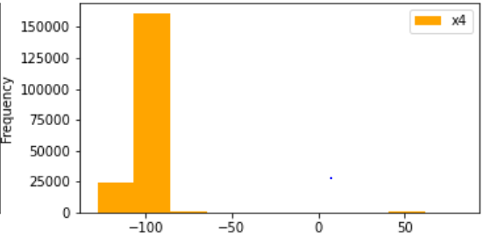
Exploratory Data Analysis
Changed ‘!’ To Null while importing data into dataframe.
Deleted records where y was null.
Replaced Nulls in x1 column with mean value.
Checked Data for Outliers -‘x4’ has outliers.
Out of all the pipelines ,the pipeline with random forest Regressor performed the best.
mse :0.6626940284220522
mae :0.4079155216224845
rmse :0.8140602117915187
So,we can fine tune randomforest Regressor with GridSearchCV(also we can remove column x2 as column x2 is not important)

